Slide 1
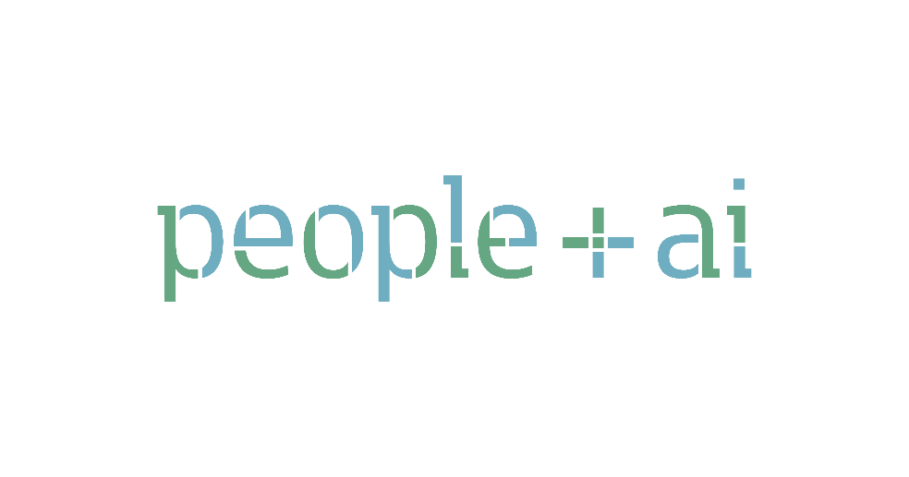

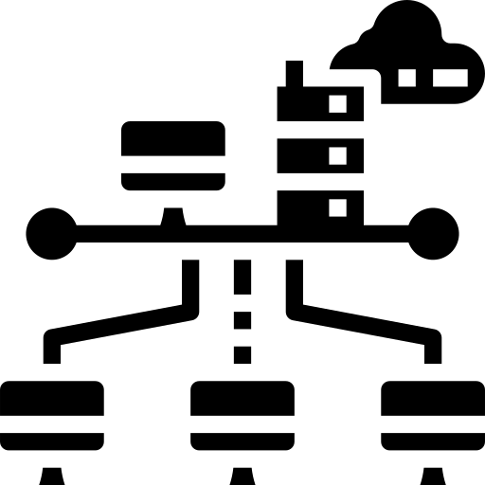


What We Do
Discover, demonstrate and distribute population-scale use-cases for AI in India.
Infrastructure to help builders scale those use cases to everyone.
Cheerlead good ideas & silent heroes. Deep Thinking & Dissemination of the Indian PoV on AI.
Grow Community & setup open spaces for collaboration

Slide 2
What We Do
Discover, demonstrate and distribute population-scale
use-cases for AI in India.

Slide 3
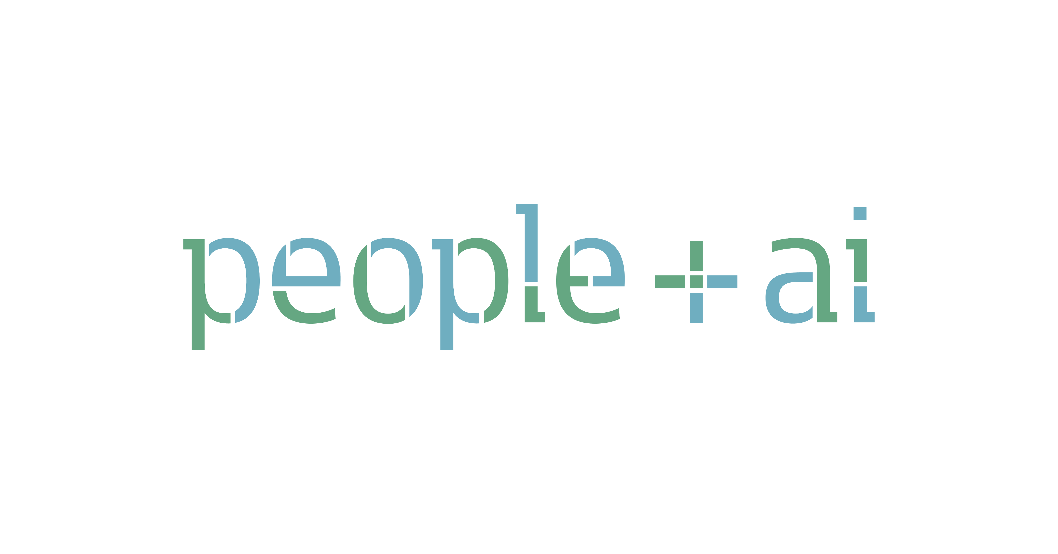


Slide 4
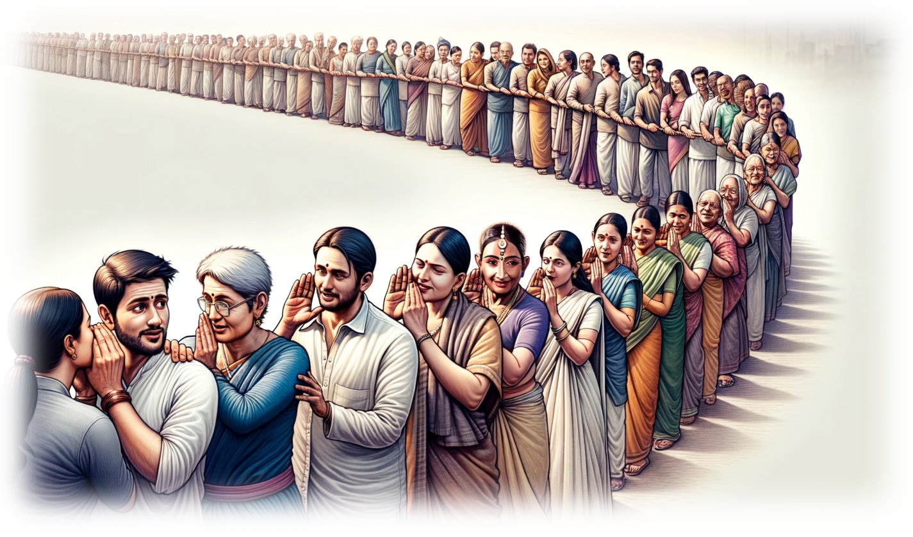

Listening to Users
is Chinese Whispers …

Slide 5
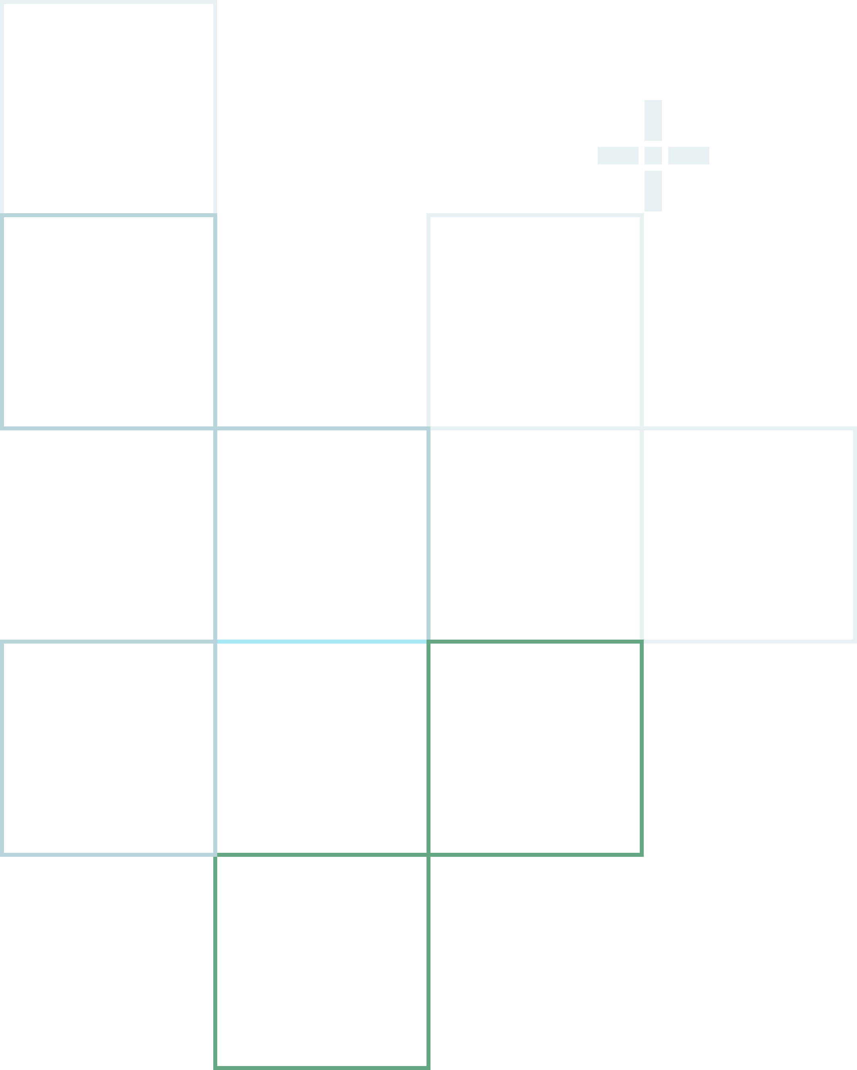

What if AI could help you cut through the noise?

Slide 6
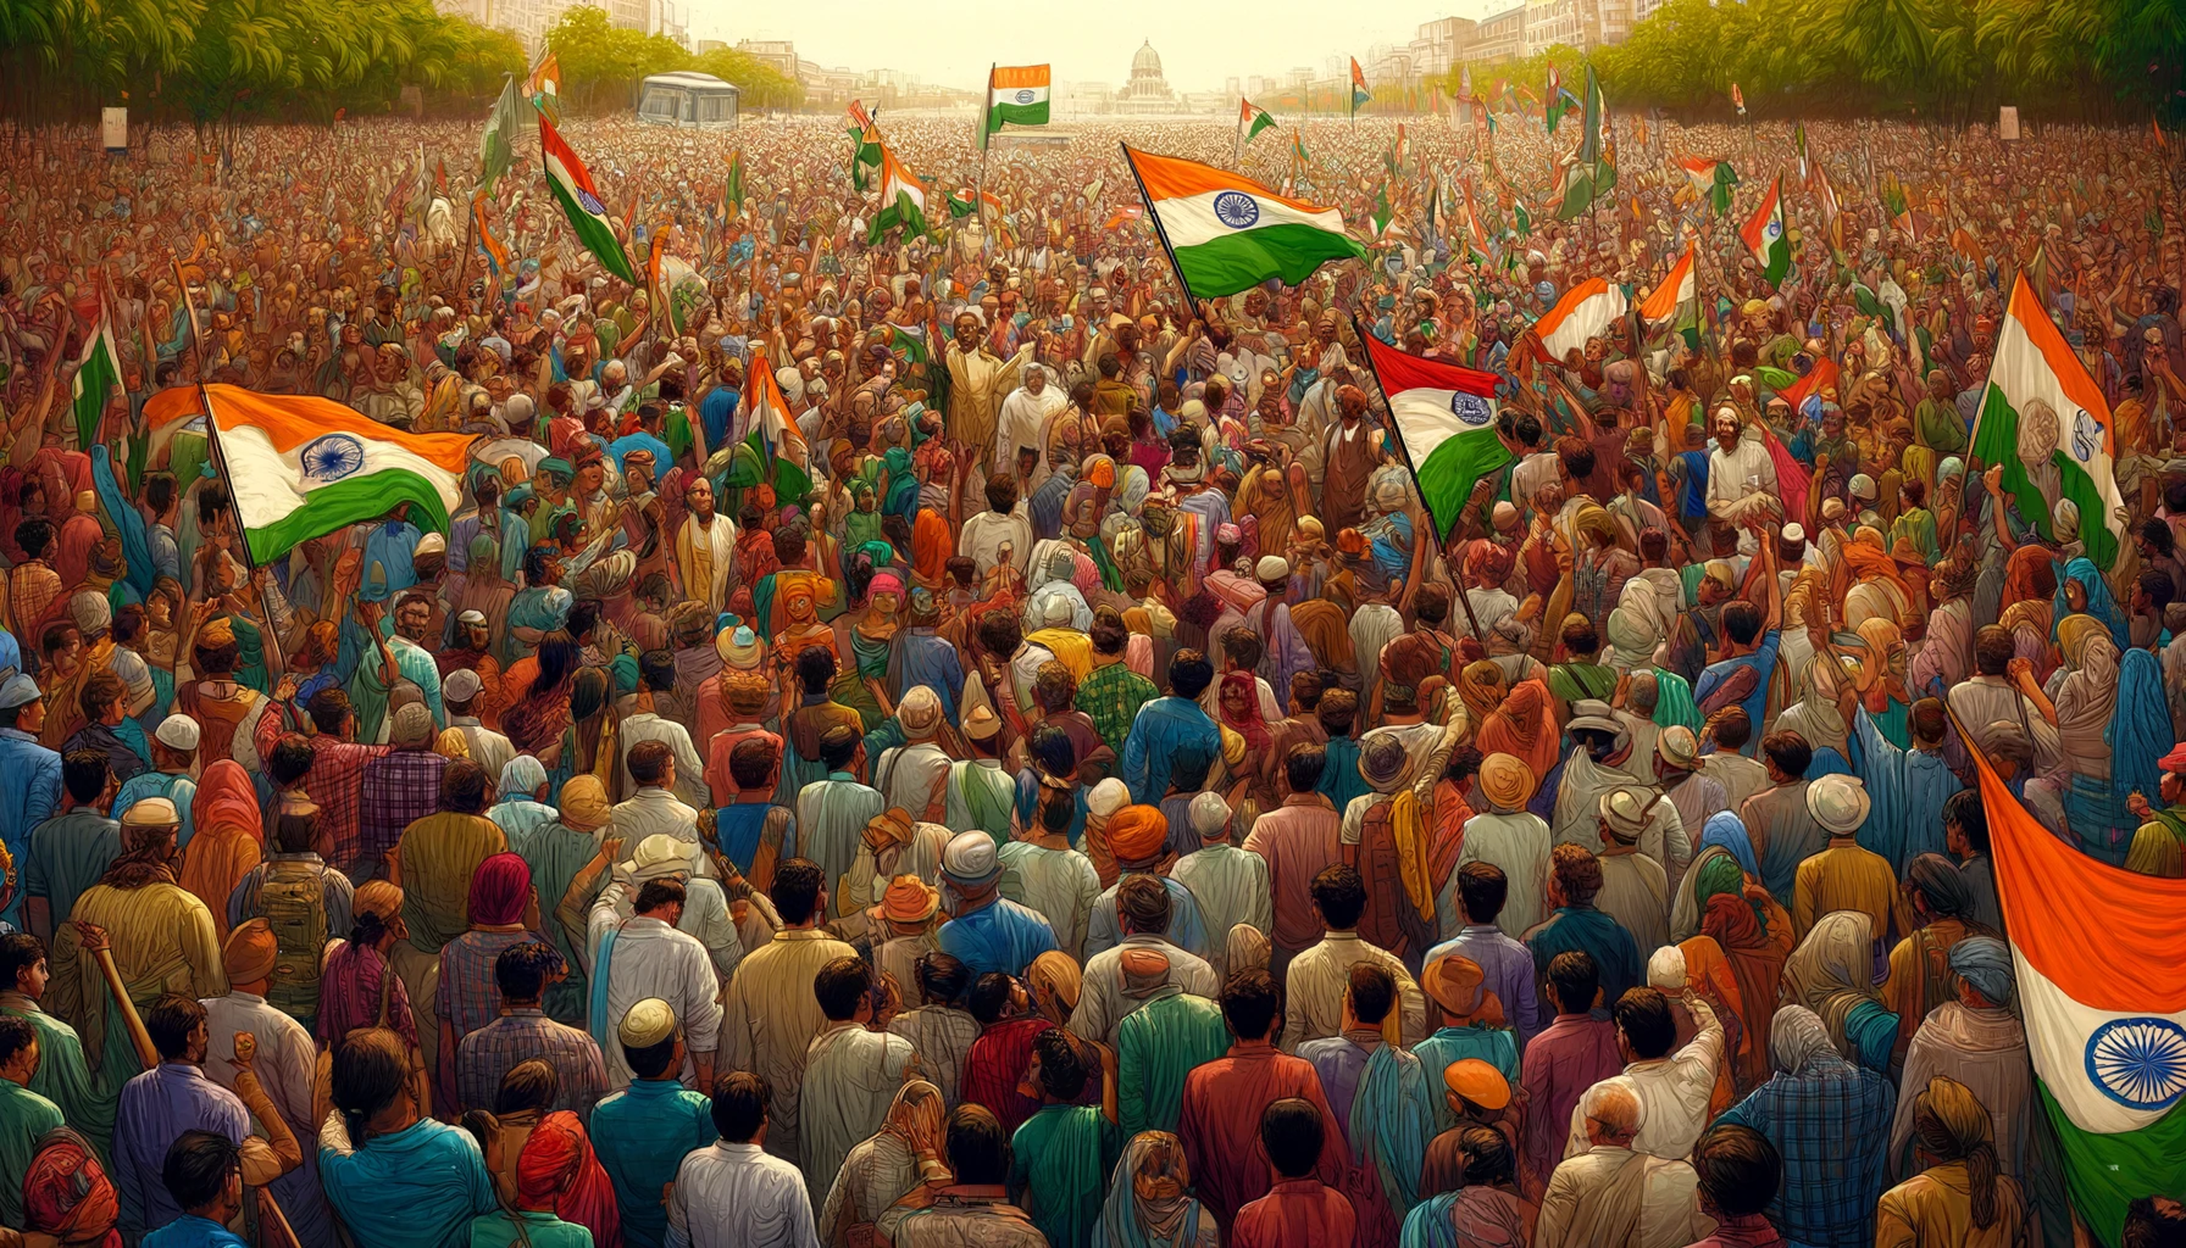


Slide 7
Listening at Scale

Slide 8

Step 1
The user initiates:
Asks bot a question
Step 2
Retrieving data from millions of existing data sources
Step 3
Curates a response for the Question
Based on available data
PINGALI VENKAYYA
USER
WHO DESIGNED THE INDIAN NATIONAL FLAG?
Notes:
Why is the robot appearing before efverything else?
Also, can we use the arrow consistently from the next slide but in reverse direction.

Slide 9
Introducing a twist
Notes:
Why is the robot appearing before efverything else?
Also, can we use the arrow consistently from the next slide but in reverse direction.

Slide 10
Step 2
Gives information/opinion/data
Step 1
Asks for opinion
/information
USER
RED
WHAT’S YOUR
FAVOURITE COLOUR?
Notes:
Why is the robot appearing before efverything else?
Also, can we use the arrow consistently from the next slide but in reverse direction.

Slide 11
Step 2
Gives information/opinion/data
Step 3
Draws insights
Step 1
Asks for opinion
/information
USER 2
USER
RED
WHAT’S YOUR
FAVOURITE COLOUR?
USER 3
Notes:
Why is the robot appearing before efverything else?
Also, can we use the arrow consistently from the next slide but in reverse direction.

Slide 12
Step 2
Gives information/opinion/data
Step 3
Draws insights
Step 1
Asks for opinion
/information
USER 2
USER
RED
WHAT’S YOUR
FAVOURITE COLOUR?
USER 3
Notes:
Why is the robot appearing before efverything else?
Also, can we use the arrow consistently from the next slide but in reverse direction.

Slide 13


Let’s See It In Action
Notes:
Please make this more home lookey- maybe use one of the dark slates for this

